Slide 1

Software Testing
Unit 2
White Box Testing
Prof Raghu B. A. Rao
Department of Computer Science and Engineering
‹#›
‹#›
‹#›

Slide 2

White Box & Testing
List of Contents
White Box Testing - Overview
White Box Testing in SDLC
Limitations of White Box Testing
Types of White Box Testing
Static Testing
Desk Checking
Code Walkthrough
Code Inspection / Fagan Inspection
Formal Inspection - Roles, Process, Adv & Disadv
Tool Usage for Static Analysis
Static Analysis Tool - LINT
Department of Computer Science and Engineering

Slide 3
What is White Box Testing
White Box Testing is the testing based on the knowledge of how the software solution's internal structure is.
It focuses primarily on strengthening quality of implementation proving design and usability.
White box testing is also known as clear box, open, structural, and glass box testing.
Requires access to code
Looks at the program code and performs testing by mapping program code to functionality
“Testing can prove presence of defects and not their absence!”

Slide 4
Objectives of White Box Testing
Finding Broken or poorly structured paths in the coding processes
The flow of specific inputs through the code
The functionality of conditional loops
Internal security holes
Defects due to common programming mistakes
Testing of each statement, object and function on an individual basis
Identify boundary values based on implementation structure
Buffer sizes for example
Identify violations to “construction” standards
Coding standards
Design specified guidelines
Professional standards

Slide 5
White Box Testing is needed
Early defect identification
Early confidence building
Reduce complexity in integrated/blackbox testing
Address both functionality and quality aspects
Maintainability, reliability, availability

Slide 6
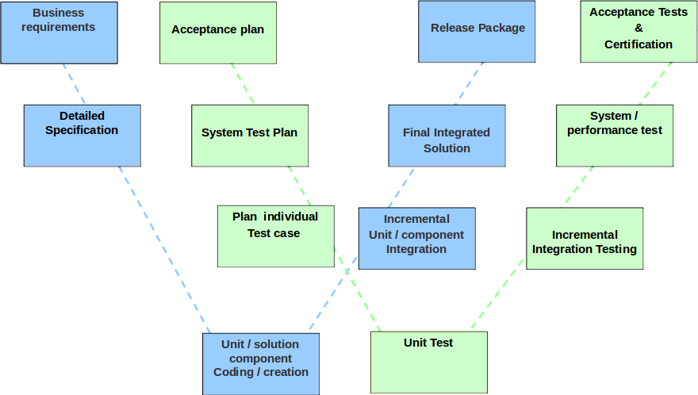

White Box Testing in SDLC

Slide 7
Why White Box Testing
The program code truly represents what the program actually does and not just what it is intended to do!
It minimizes delay between defect injection and defect detection (i.e., does not postpone detection to be done by someone else).
Can catch “obvious” programming errors that do not necessarily map to common user scenarios (e.g., divide by zero).

Slide 8
Limitation of White Box Testing
Tendency to miss the big picture
Implementation technology skill required
Progg. Language, database, environment, runtime behavior
Deeper knowledge required
Including dev skills & IDE
Effort is significantly more
Additional development may be required
Source / documentation may not be available – fully / partly.
Developers might develop blind spots for their own defects
Fully covered code may not correspond to realistic scenarios

Slide 9
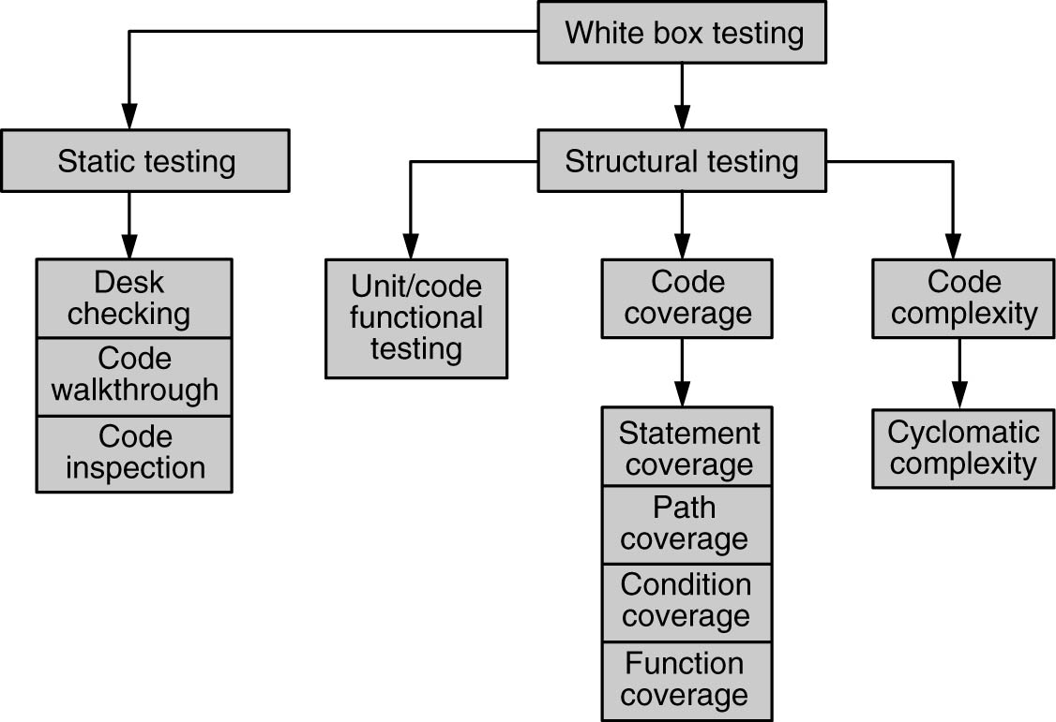
Types of White Box Testing

Slide 10
Quote
“The human eye has an almost infinite capacity for not seeing what it does not want to see. Programmers, if left to their own ways, will ignore/overlook the most glaring errors in their output—errors that anyone else can see in an instant."
- The Psychology of Computer Programming, Gerald Weinberg

Slide 11
Static Testing
Involves only the source code and not the executable
Does not involve executing the program on a machine but rather humans going through source code it or the usage of specialized tools [ No computer required! ]
Key aspects that are looked into
Whether the code works according to the functional requirement
Whether the code has been written in accordance with the design developed earlier in the project life cycle
Whether the code follows all applicable standards
Whether the code for any functionality has been missed out
Whether the code handles errors/exceptions properly
Whether the code follows professional / best practices
What are these ?
Obvious arithmetic / logical mistakes

Slide 12
Static Testing by Humans
Humans can find errors that computers can’t.
Multiple humans can provide multiple perspectives.
Errors due to ambiguities can be realized
A human evaluation can compare the code against the specifications more thoroughly.
It can detect multiple defects at one go - Helps root cause identification
It reduces downstream, inline pressure.
Verify difficult to execute paths during testing special & rare conditions.
But, Who does the testing?
Depends on type of static testing – see next.

Slide 13
Static Testing types
Different types [ All are called ‘Code Review’ ]
Desk checking of the code
Code walkthrough
Code inspection
“QA vs QC” argument
Increasing involvement of people
More variety of perspectives
Increasing formalism
Increasing the likelihood of identifying complex defects

Slide 14
Desk Checking ( Personal reviews)
Author informally checks the code against the specifications and corrects defects found.
No structured method or formalism is required to ensure completeness.
No log or checklist is maintained.
It relies only on the thoroughness of the author.
It may suffice for “obvious” programming errors but may not be effective for incomplete / misunderstood requirements.

Slide 15
Advantages and Disadvantages of Desk Checking
Advantages
The programmer knows the code and programming language well and hence is best suited to read the program
Less scheduling and logistics overheads
Reduces delay in defect detection and correction
Disadvantages
Person dependent, not scalable or reproducible
Tunnel vision of developers
Developers prefer writing new code and don’t like testing

Slide 16
Code Walkthrough
Group oriented (as against desk checking)
Brings in multiple perspectives
Multiple specific roles (author, moderator, inspector, etc.), as discussed in Fagan Inspection
Simpler Variant
Another peer/Senior person goes through the code alone after an initial brief and occasional clarifications
More common and efficient too.

Slide 17
Code Inspection / Fagan Inspection
Group-oriented activity
Highly formal and structured
Multiple participants with specific roles
Requires thorough preparation
Documentation of diverse views
Review in a defined structured manner.

Slide 18
Roles in a Formal Inspection
Author
Author of the work product
Makes available the required material to the reviewers
Fixes defects that are reported
Moderator
Controls the meeting(s)
Inspectors (reviewers)
Prepare by reading the required documents
Take part in the meeting(s) and report defects
Scribe
Takes down notes during the meeting
Assigned in advance by turns
Can participate to review to the extent possible
Documents the minutes and circulates them to participants

Slide 19
Documents in a Fagan Inspection
Typical documents circulated:
Program code
Design / program specifications
SRS (if needed)
Any applicable standards (e.g., coding standards)
Any necessary checklists (e.g., code review checklist)

Slide 20
Meetings in a Fagan Inspection
Preliminary meeting (optional)
Author explains his / her perspective
Makes available the necessary documents
Highlights concern areas, if any, for which review comments are sought
Defect Logging Meeting
All come prepared!
Moderator goes through the code sequentially
Each reviewer comes up with comments
Comments / defects categorized as “defect” / “observation,” “major” / “minor,” “systemic” / “mis-execution”
Scribe documents all the findings and circulates them
Follow-up meeting (optional)
After Author fixes defects
If required, a follow-up meeting is called to verify completeness of fixes

Slide 21
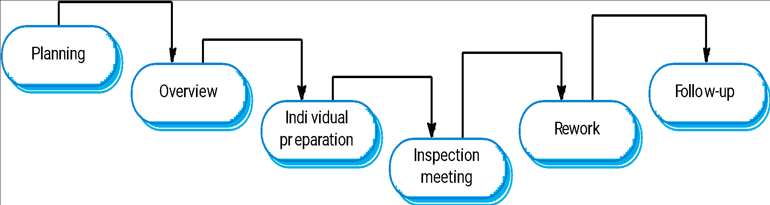
Inspection Process

Slide 22
Advantages and Disadvantages of Fagan Inspection
Advantages
Thorough, when prepared well
Brings in multiple perspectives
Has been found to be very effective
Disadvantages
Logistically difficult
Time consuming
May not be possible to exhaustively go through the entire code

Slide 23
Tool Usage for Static Analysis
Whether there are unreachable codes
Variables declared but not used
Mismatch in definition and assignment of values to variables
Illegal or error-prone type-casting of variables
Use of non-portable or architecture-dependent programming constructs
Memory allocated but not having corresponding statements for freeing up memory
For calculation of cyclomatic complexity
As an extension of compilers (lint, compiler flag driven checking…)
Coding standards adherence
Variable naming, indentation, in-line documentation……
Best practice violations – Hard codings…
https://www.softwaretestinghelp.com/tools/top-40-static-code-analysis-tools/

Slide 24
Static Analysis Tool - LINT
#include <stdio.h>
printarray (Anarray)
int Anarray;
{ printf(“%d”,Anarray); }
main ()
{
int Anarray[5]; int i; char c;
printarray (Anarray, i, c);
printarray (Anarray) ;
}
----------------------- Tool execution
lint lint_ex.c
------------------------ Output
lint_ex.c(10): warning: c may be used before set
lint_ex.c(10): warning: i may be used before set
printarray: variable # of args. lint_ex.c(4) :: lint_ex.c(10)
printarray, arg. 1 used inconsistently lint_ex.c(4) :: lint_ex.c(10)
printarray, arg. 1 used inconsistently lint_ex.c(4) :: lint_ex.c(11)
printf returns value which is always ignored

Slide 25
THANK YOU
Prof Raghu B. A. Rao
Department of Computer Science and Engineering

